Slide 1
Different types of equations
Solving linear equations

Slide 2
how to use Oak lessons

Slide 3
I can recognise that there are many different types of equations of which linear is one type.

Slide 4
Expressions contain one or more terms, where each term is separated by an operator.
An equation is used to show that one number or calculation is equal to another.
The relationship between two variables is linear if, when plotted on a pair of axes, a straight line is formed.
The gradient is a measure of how steep a line is. It is calculated by finding the rate of change in the y-direction with respect to the positive x-direction.

Slide 5

Different types of equations
Reviewing plotting graphs
Identifying linear equations from graphs

Slide 6
Reviewing plotting graphs
Equations which show a relationship between two variables can be plotted on a graph.
The relationship between two variables is linear if it forms a straight line when plotted.
If the graph of a relationship is not a straight line then the relationship is non-linear.
How could we plot the relationship y = x² − 2 ?
Pick some coordinates that follow the rule.

Slide 7

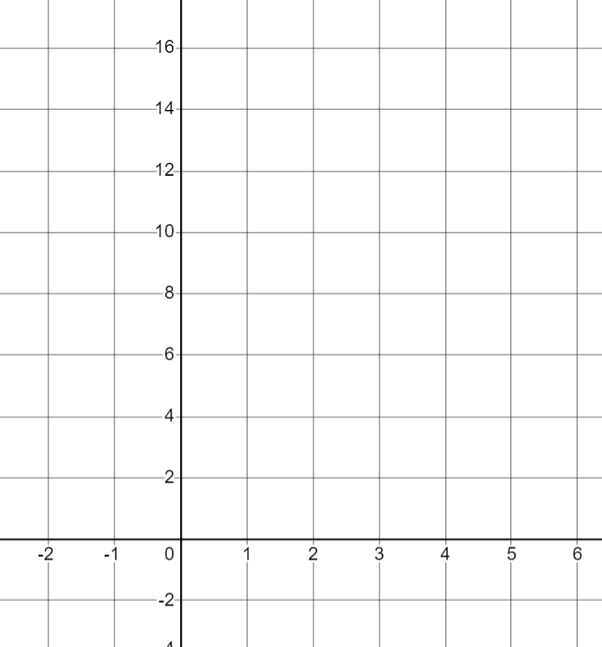

Reviewing plotting graphs
How could we plot the relationship y = x² − 2 ?
I think the coordinate (2, 2) is on the graph.
Sofia
How could we check if Sofia is correct?
×
(2)²− 2 = 2
Substituting 2 as the x-coordinate gives a y-coordinate of 2 so (2, 2) is on the graph.

Slide 8

Reviewing plotting graphs
How could we plot the relationship y = x² − 2 ?
I think the coordinate (2, 2) is on the graph.
×
Sofia
Let’s plot the coordinate when x = 4 as well.
How could we work out the coordinate Aisha wants to plot?
×
Aisha
(4)²− 2 = 14
so (4, 14) is on the graph.

Slide 9

Reviewing plotting graphs
How could we plot the relationship y = x² − 2 ?
Now we can plot those two coordinates and draw the line between them.
×
Sofia
So this is a linear graph.
But I don’t think y = x² − 2 is a linear relationship, so how can its graph be a straight line?
×
Aisha
Jun
What do you think to these three statements?

Slide 10
Reviewing plotting graphs
What do you think to these 3 statements?
The coordinates they have plotted are correct and will be on the graph.
However they can only join 2 points with a straight line if they know the graph should be linear.
They have not plotted enough points to know whether they form a straight line, most relationships do not.
Jun is correct that y = x² − 2 is not a linear relationship. Only linear relationships form straight lines.
The graph of y = x² − 2 will not be a linear graph so will not form a straight line.

Slide 11
Reviewing plotting graphs
How could we plot the relationship y = x² − 2 if we don’t know that it’s linear?
We could use a table of values to plot some more points.
×
Sofia
x | −2 | −1 | 0 | 1 | 2 | 3 | 4 | 5
y
×
2
−1
−2
−1
2
7
14
23
×
×
(0)²− 2 = −2
(3)²− 2 = 7
(−1)²− 2 = −1
(1)²− 2 = −1
(5)²− 2 = 23
(−2)²− 2 = 2
×
×
×
The graph of this relationship is a curve.

Slide 12
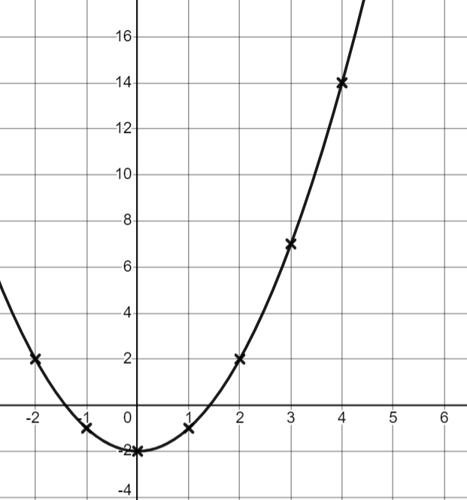
Reviewing plotting graphs
Has Sofia now plotted the graph of all points that fit this relationship?
No, she could have used non-integer coordinates
There are an infinite number of coordinates that follow this relationship. We have only plotted a few to see the relationship.
×
×
If we wanted to show the graph of all points, we would need to draw a curve.
×
×
×
×
If we just want an idea of what the relationship looks like, it is okay just to plot the integer coordinates.
×

Slide 13
Reviewing plotting graphs
If we know a relationship between two variables is linear then we only need to plot two points as we know it will form a straight line.
It is always a good idea to plot a third point to help spot mistakes.
If we do not know whether a relationship is linear then plotting from a table of values helps us see the shape of the graph.

Slide 14
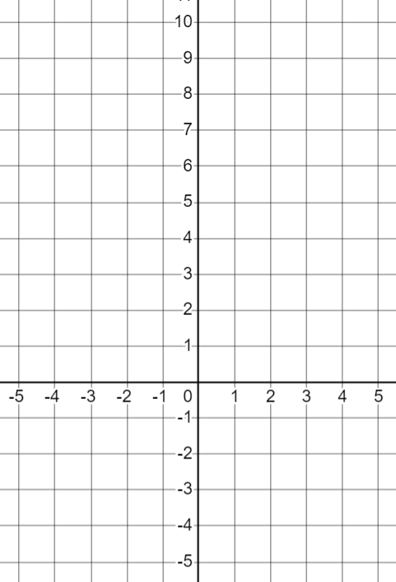
Reviewing plotting graphs
We can graph expressions by looking at how the value of the expression changes for different values of the variable.
×
3a + 4
How could we graph the expression 3a + 4 ?
×
We could label the horizontal (x)-axis ‘a’
×
On the y-axis we could plot the value of 3a + 4 as a varies.
×
a | −4 | −3 | −2 | −1 | 0 | 1 | 2 | 3 | 4
3a + 4
×
a
−8
−5
−2
1
4
7
10
13
16
×

Slide 15
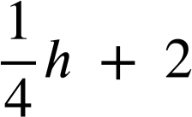
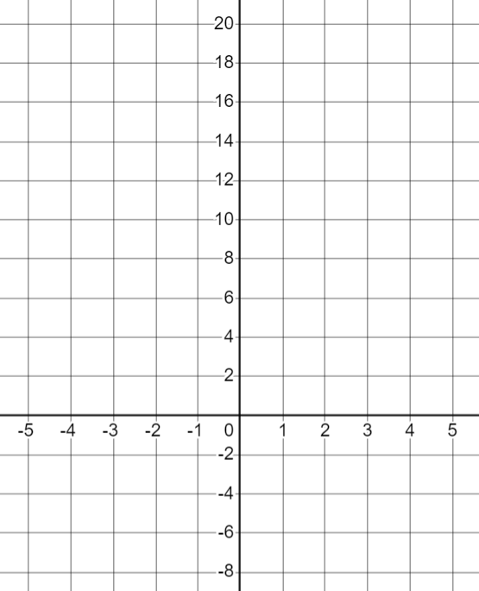
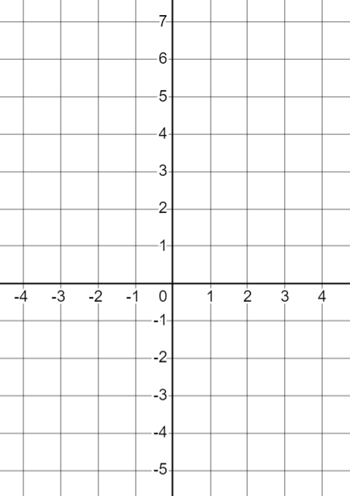
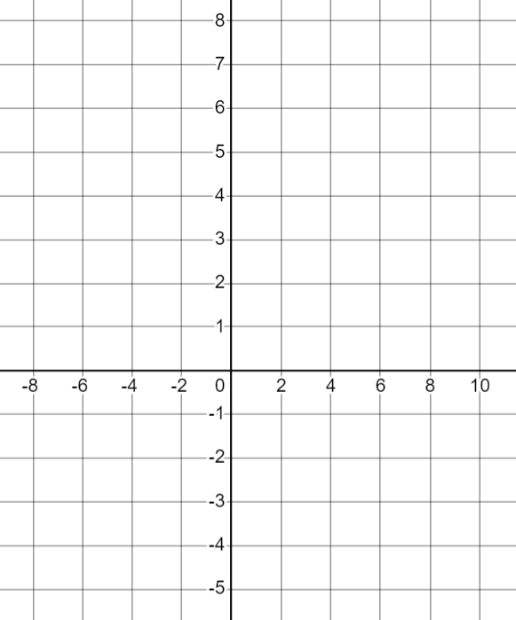
Reviewing plotting graphs
How could we investigate the graphs of the following expressions? What do you notice about the axes I have drawn?
b² − 5
3 − 2t
They have different scales.
Make sure you read the scales on the axes carefully.
If you are drawing your own axes you should fill in the table of values first so you can decide on an appropriate scale.

Slide 16
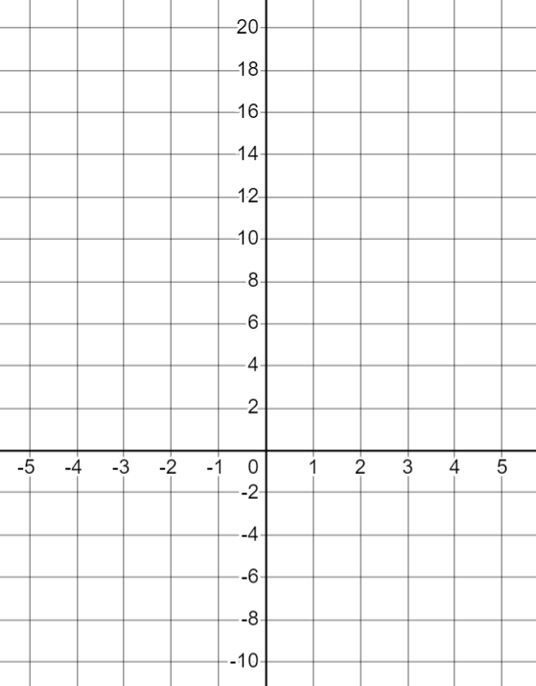
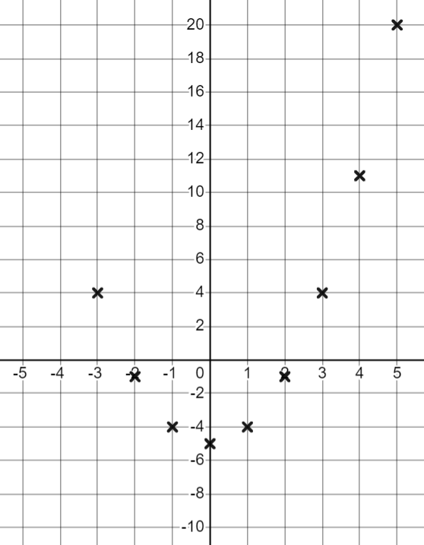
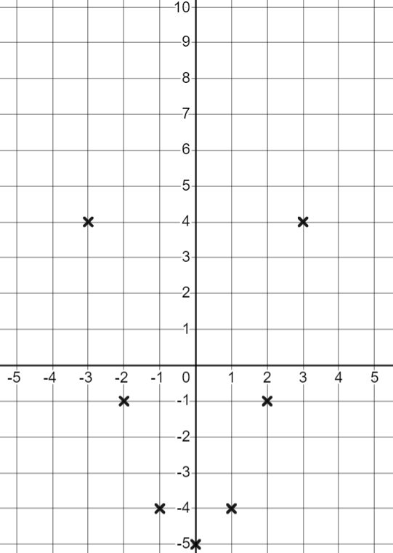
Reviewing plotting graphs
b² − 5
We have only plotted coordinates between x = −3 and x = 5.
b² − 5
But this does give us an idea about how the expression changes as the variable changes.
Be aware that changing the scales does change the shape of the graph in some ways.
b
What do you notice about the graph when plotted on axes with a step of 1?
b | −3 | −2 | −1 | 0 | 1 | 2 | 3 | 4 | 5
b² − 5
4
−1
−4
−5
−4
−1
4
11
20
The curve is narrower.

Slide 17
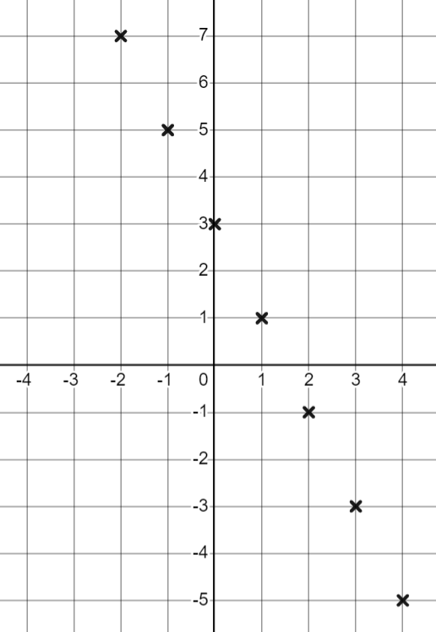
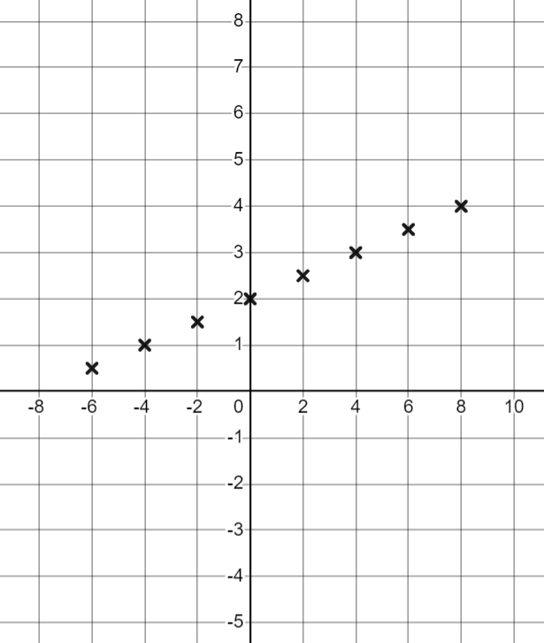
Reviewing plotting graphs
3 − 2t
3 − 2t
h
t
h | −6 | −4 | −2 | 0 | 2 | 4 | 6 | 8
0.5
1
1.5
2
2.5
3
3.5
4
t | −3 | −2 | −1 | 0 | 1 | 2 | 3 | 4
3 − 2t
9
7
5
3
1
−1
−3
−5
Work out the coordinates with positive x values first.
Pick values for h which will give easy values to plot.

Slide 18

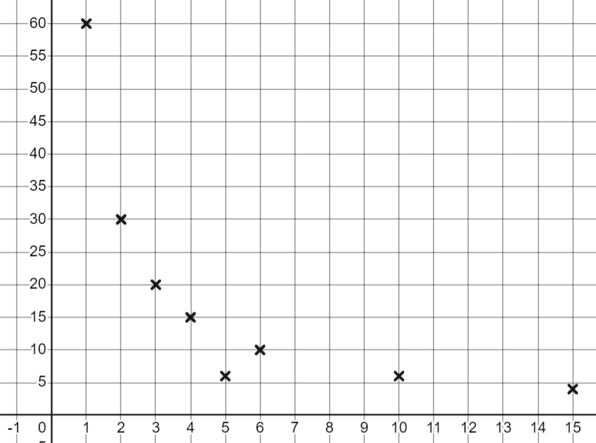
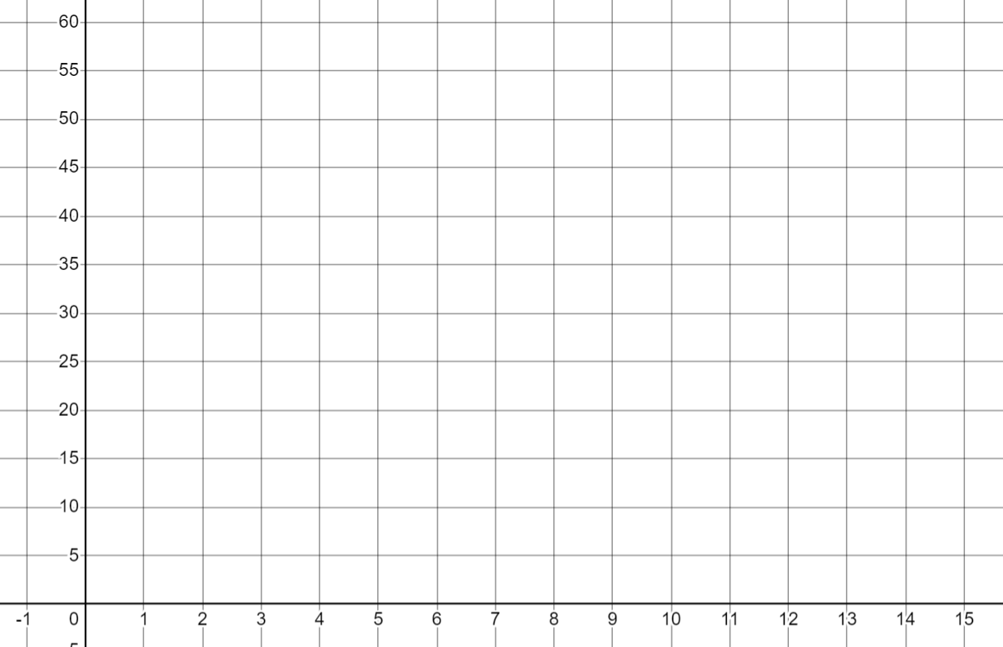
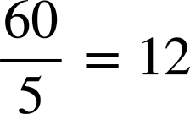
Reviewing plotting graphs
Andeep is plotting the graph of the expression
a) Give an example of something he has done well.
x | 1 | 2 | 3 | 4 | 5 | 6 | ..10 | ..15
y | 60 | 30 | 20 | 15 | 6 | 10 | 6 | 4
He has drawn a table of values.
He chose x-values that gave integer y-values
He used the y-axis scale correctly.
b) Spot any mistakes.
He has made a mistake with this coordinate which has then been plotted wrong.

Slide 19
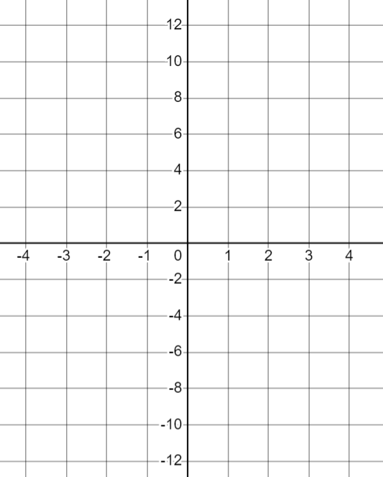
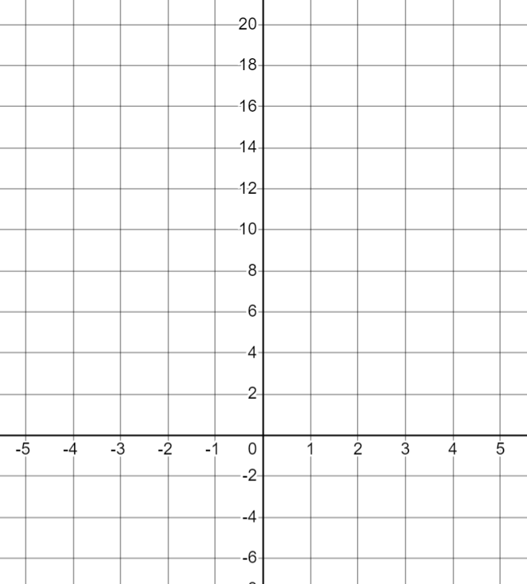
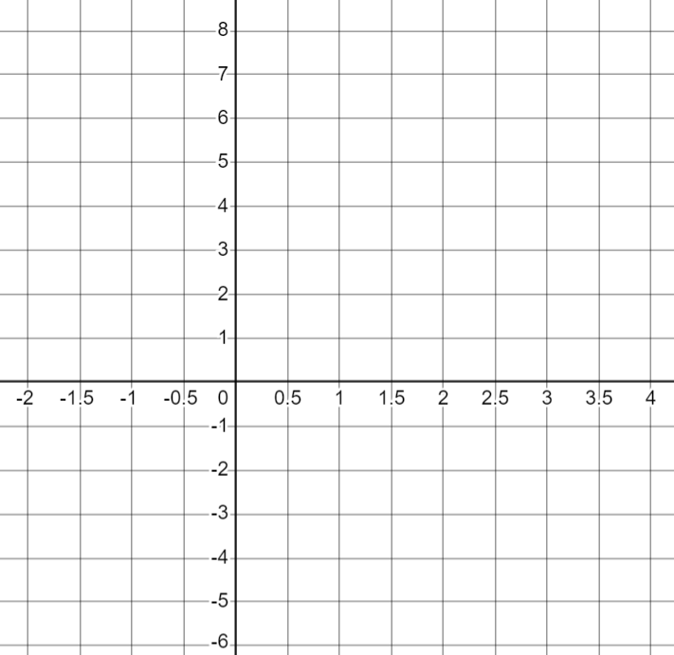
Reviewing plotting graphs
1) Fill in the table of values, plot the points for the graphs of each expression.
a) 4a − 5 | b) a² − 5 | c) 5 − 3a
a | −1 | 0 | 1 | 2 | 3 | 4
4a − 5 | −9 |  |  |  | 7
a | −2 | −1 | 0 | 1 | 2 | 3 | 4
a² − 5 | −1 |  |  |  |  |  | 11
a | −1 | 0 | 1 | 2 | 3 | 4
5 − 3a |  |  |  |  |  | −7
4a − 5
a² − 5
5 − 3a
a
a
a

Slide 20


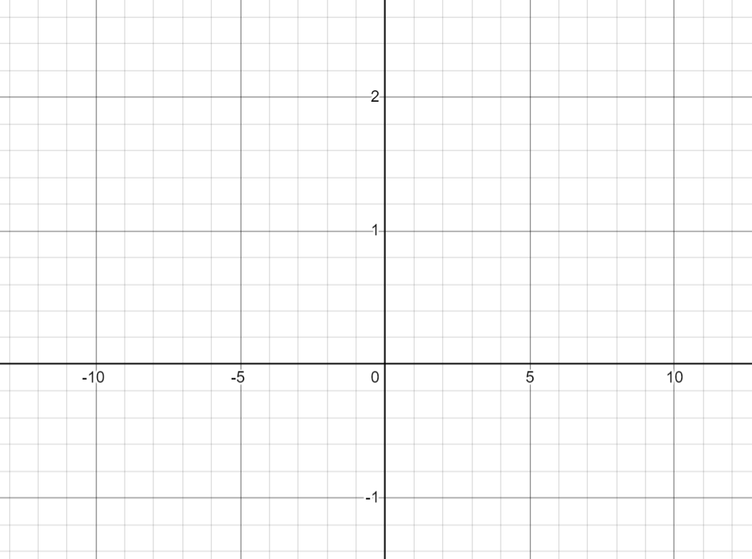
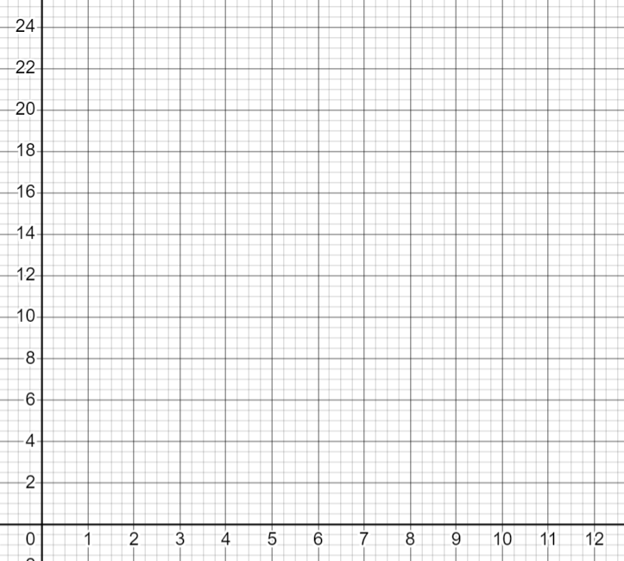
Reviewing plotting graphs
1) Fill in the table of values, plot the points for the graphs of each expression.
d) | e)
b | −10 | −5 | 0 | 5 | 10
 |  |  | 0
x | 1 | 2 | 3 | 4 | 5 | 6 | ..8 | ..10 | ..12
 |  |  | 8 |  |  |  | 3

Slide 21
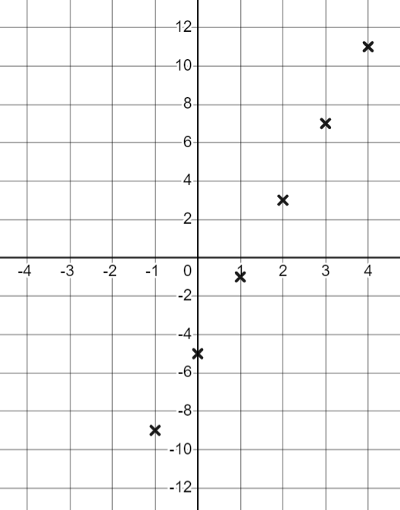
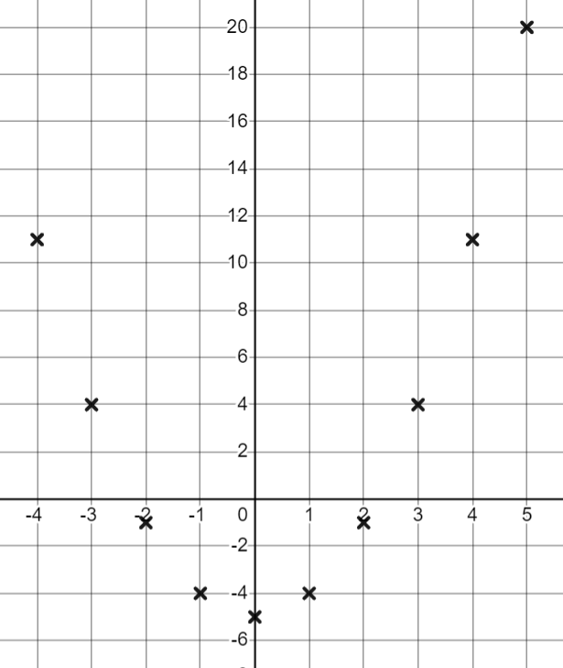
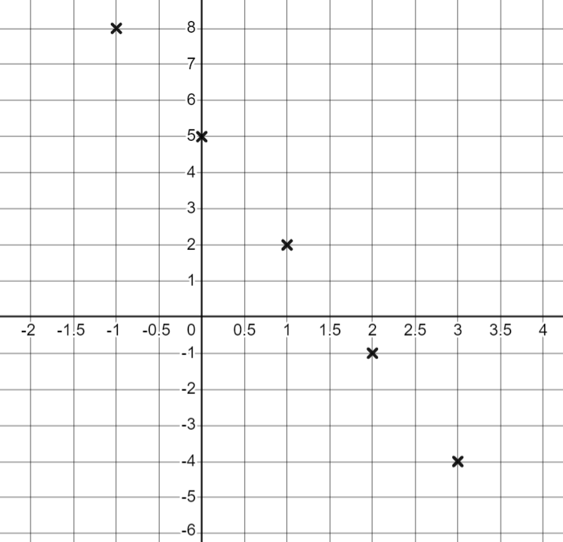
Reviewing plotting graphs
1) Fill in the table of values, plot the points for the graphs of each expression.
a) 4a − 5 | b) a² − 5 | c) 5 − 3a
a | −1 | 0 | 1 | 2 | 3 | 4
4a − 5 | −9 | −5 | −1 | 3 | 7 | 11
a | −2 | −1 | 0 | 1 | 2 | 3 | 4
a² − 5 | −1 | −4 | −5 | −4 | −1 | 4 | 11
a | −1 | 0 | 1 | 2 | 3 | 4
5 − 3a | 8 | 5 | 2 | −1 | −4 | −7

Slide 22
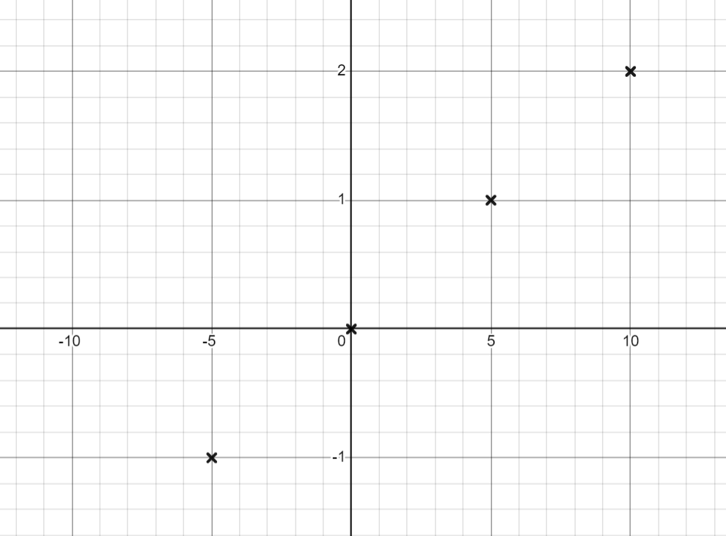
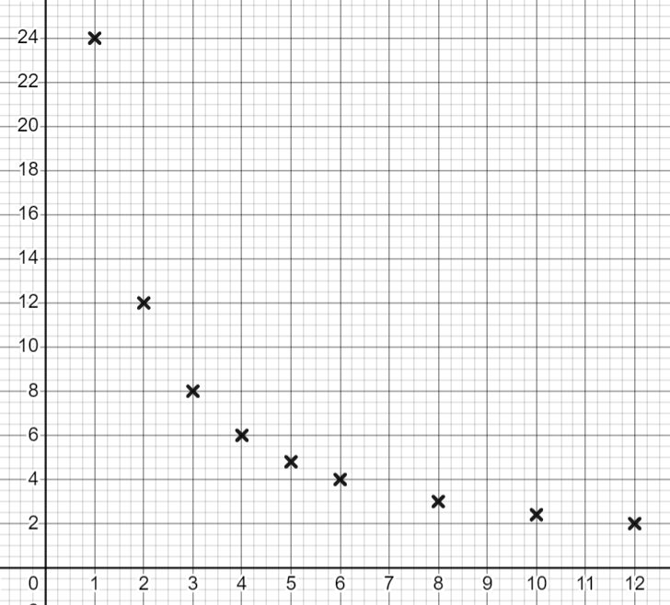
Reviewing plotting graphs
1) Fill in the table of values, plot the points for the graphs of each expression.
d) | e)
b | −10 | −5 | 0 | 5 | 10
 | −2 | −1 | 0 | 1 | 2
x | 1 | 2 | 3 | 4 | 5 | 6 | ..8 | ..10 | ..12
 | 24 | 12 | 8 | 6 | 4.8 | 4 | 3 | 2.4 | 2

Slide 23
Different types of equations
Reviewing plotting graphs
Identifying linear equations from graphs

Slide 24
Identifying linear equations from graphs
Equations of straight lines can have many forms. You may have seen them written in the form y = mx + c
Examples:
y = 2x + 3
y = 2 − 4x
y = x − 5
y = 17x − 0.2
Are there any values of m and c which would not form a linear graph? You could use graphing software to help you explore.
All constant values for m and c will form a linear graph with gradient m and y intercept (0, c)
If m or c are variables then it is possible to make a relationship which is non-linear.

Slide 25

Identifying linear equations from graphs
Here is the table of values for y = 2x + 3
+ 1
+ 1
+ 1
+ 1
+ 1
x | −3 | −2 | −1 | 0 | 1 | 2 | 3 | 4
y | −3 | −1 | 1 | 3 | 5 | 7 | 9 | 11
+ 2
+ 2
+ 2
+ 2
+ 2
How do we know that this will form a linear graph when plotted?
As x increases by 1, y increases by 2 every time. The graph will have a gradient of 2
Equations that form a linear graph when plotted are linear equations.

Slide 26
Identifying linear equations from graphs
It is easier to see if an equation with two variables forms a linear graph if it’s written in the form y = mx + c
Which of these are linear equations?
y = x + 1
y = x²+ 1
y = x³+ 1
+ 1
+ 1
+ 1
+ 1
+ 1
+ 1
+ 1
+ 1
+ 1
+ 1
+ 1
+ 1
x | −2 | −1 | 0 | 1 | 2
y | −1 | 0 | 1 | 2 | 3
x | −2 | −1 | 0 | 1 | 2
y | 5 | 2 | 1 | 2 | 5
x | −2 | −1 | 0 | 1 | 2
y | −7 | 0 | 1 | 2 | 9
+ 1
+ 1
+ 1
+ 1
−3
−1
+ 1
+ 3
+7
+1
+ 1
+ 7

Slide 27
Identifying linear equations from graphs
Which of these are linear equations?
y = x + 1
y = x²+ 1
y = x³+ 1
+ 1
+ 1
+ 1
+ 1
+ 1
+ 1
+ 1
+ 1
+ 1
+ 1
+ 1
+ 1
x | −2 | −1 | 0 | 1 | 2
y | −1 | 0 | 1 | 2 | 3
x | −2 | −1 | 0 | 1 | 2
y | 5 | 2 | 1 | 2 | 5
x | −2 | −1 | 0 | 1 | 2
y | −7 | 0 | 1 | 2 | 9
+ 1
+ 1
+ 1
+ 1
−3
−1
+ 1
+ 3
+7
+1
+ 1
+ 7
y = x + 1 is linear as it has a constant gradient.
y = x²+ 1 and y = x³+ 1 are not linear as they do not have constant gradients.

Slide 28
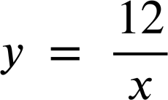
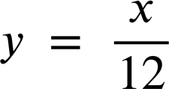





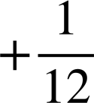
Identifying linear equations from graphs
Which of these are linear equations?
+ 1
+ 1
+ 1
+ 1
+ 1
+ 1
+ 1
+ 1
x | 1 | 2 | 3 | 4 | 5
y | 12 | 6 | 4 | 3 | 2.4
x | 1 | 2 | 3 | 4 | 5
y
−6
−2
−1
−0.6
is not linear.
is linear.

Slide 29
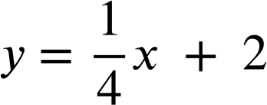

Identifying linear equations from graphs
Here is a table of values for the graph of the equation:
+ 4
+ 4
+ 1
+ 1
+ 2
+ 4
x | −8 | −4 | 0 | 1 | 2 | 4 | 8
y | 0 | 1 | 2 | 2.25 | 2.5 | 3 | 4
This is not a linear equation because the y values do not increase by the same amount each time.
+ 1
+ 1
+ 0.25
+ 0.5
Is Izzy correct?
No, because the x values do not increase by 1
Izzy
We can only use the table of values to spot a constant gradient if the x values are increasing by 1 each time.
In fact, this equation is in the form y = mx + c so will be linear

Slide 30
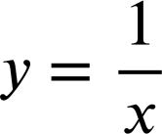


Identifying linear equations from graphs
Linear equations can take many forms and some are harder to identify than others.
Here are some more equations with 2 variables:
2y − x = 5
y = (x + 2)(x + 1)
y + x = 2x + 3x - 4
Which do you think are linear?
It is not easy to see if they are linear, we can draw their graphs to help.

Slide 31
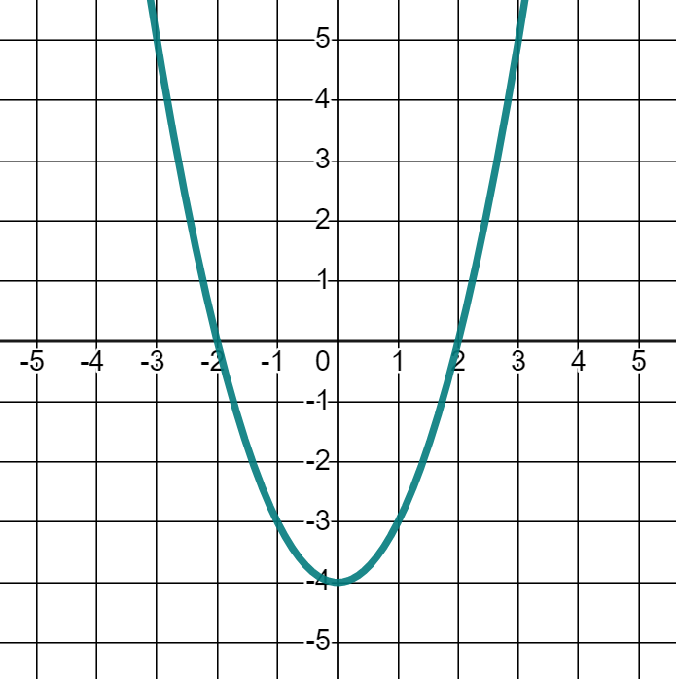
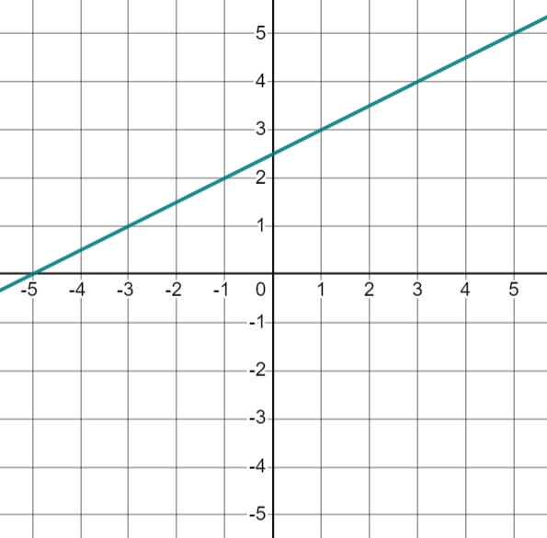
Identifying linear equations from graphs
2y − x = 5
Coordinates that follow this rule:
Coordinates that follow this rule:
(1, 3)
(3, 4)
(5, 5)
(7, 6)
E.g. When
x = (−2)
y = (−2)² − 4
y = 4 − 4
y = 0
(−2, 0)
(−1, −3)
(0, −4)
(1, −3)
(2, 0)
(3, 5)
So 2y − x = 5 is a linear equation
Not linear

Slide 32
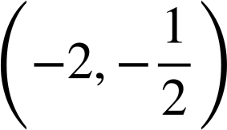
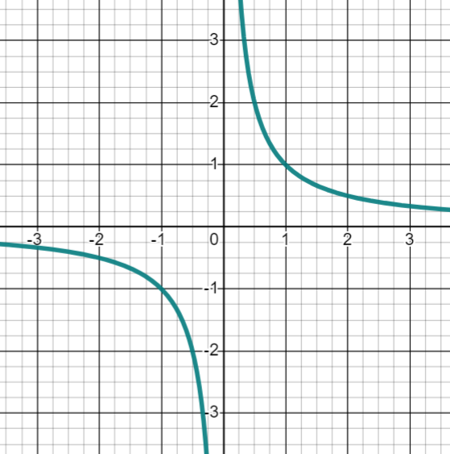
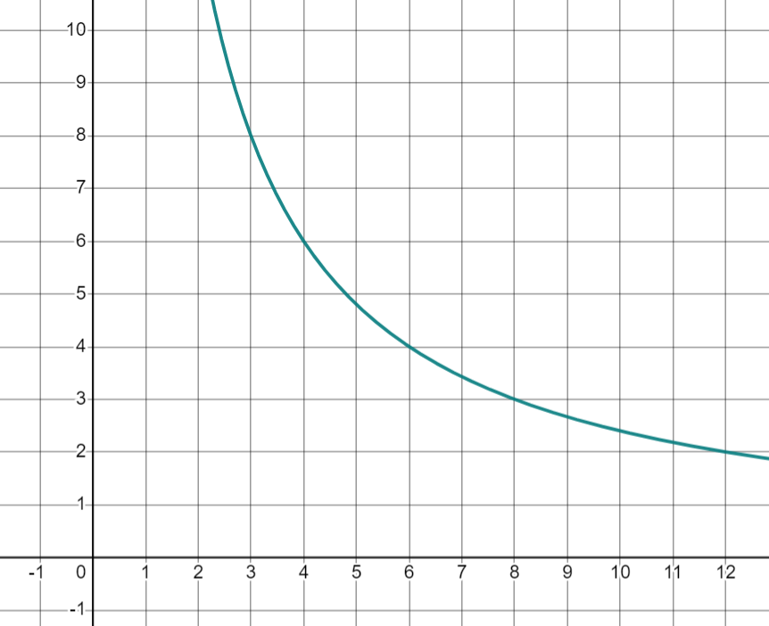
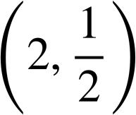
Identifying linear equations from graphs
Coordinates that follow this rule:
Coordinates that follow this rule:
(2, 12)
(3, 8)
(4, 6)
(6, 4)
(1, 1)
(−1, −1)
Non-linear
Not linear

Slide 33
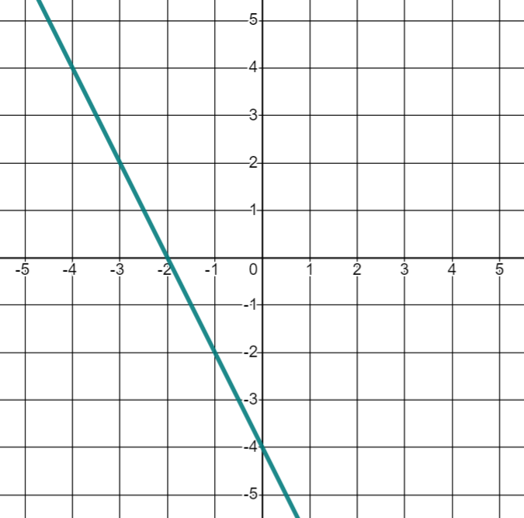
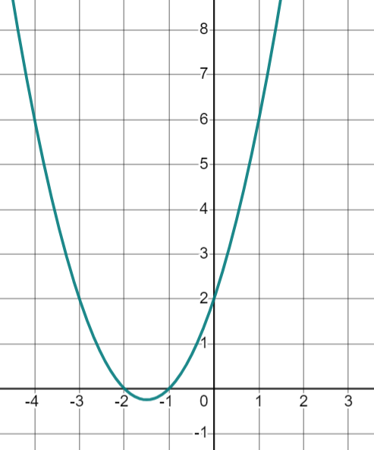
Identifying linear equations from graphs
y = (x + 2)(x + 1)
y + x = 2x − 3x − 2²
Coordinates that follow this rule:
Coordinates that follow this rule:
E.g. When x = −2
y + (−2) = 2(−2) − 3(−2) − 2²
y − 2= −4 + 6 − 4
y − 2 = −2
y = 0
((−1)+ 2)((−1) + 1) = 1 × 0 = 0
((0)+ 2)((0) + 1) = 2 × 1 = 2
((1)+ 2)((1) + 1) = 3 × 2 = 6
(−1 ,0)
(0, 2)
(−2, 0)
(−1, −2)
(1, 6)
(0, −4)
(1, −6)
Not linear
So, this equation is linear.

Slide 34
Identifying linear equations from graphs
There are many different types of equations and linear is just one type.
Some equations that may not look like typical linear equations, could be rearranged into a linear form.
For now, plotting graphs or using graphing software can help you to check if an equation is linear.
y + x = 2x + 3x − 2²
y = (x + 2)(x + 1)

Slide 35
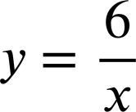
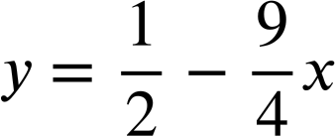
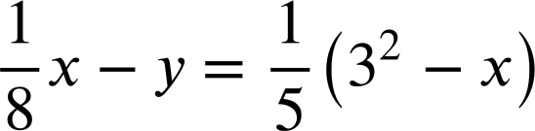
Identifying linear equations from graphs
Which of these are linear equations?
Before you see the graphs of each, have a think about which ones you think might be linear.

Slide 36
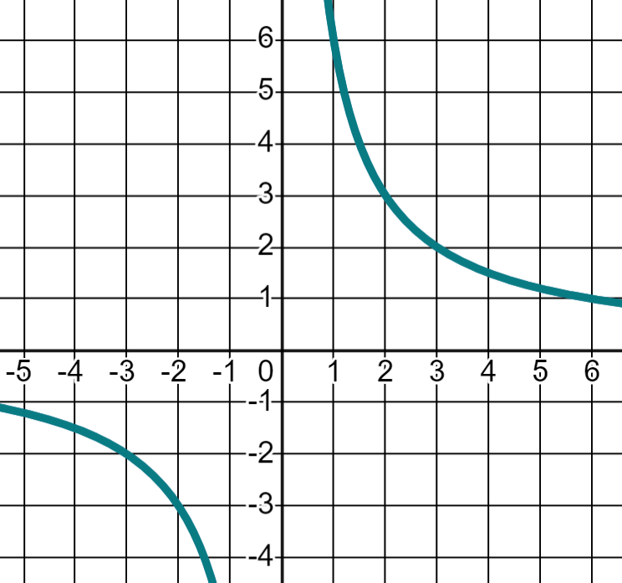
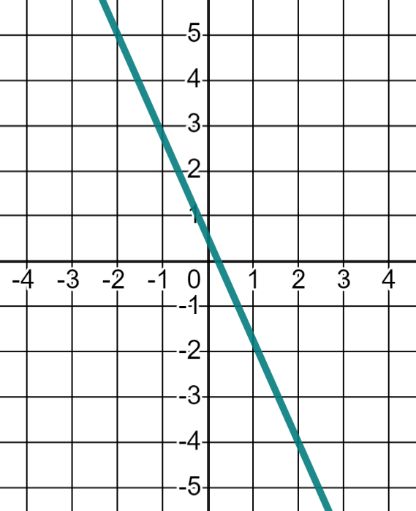
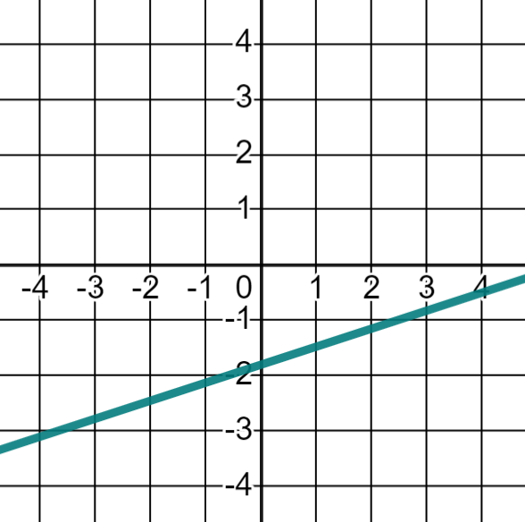

Identifying linear equations from graphs
Which of these are linear equations?

Slide 37
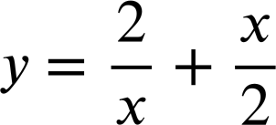


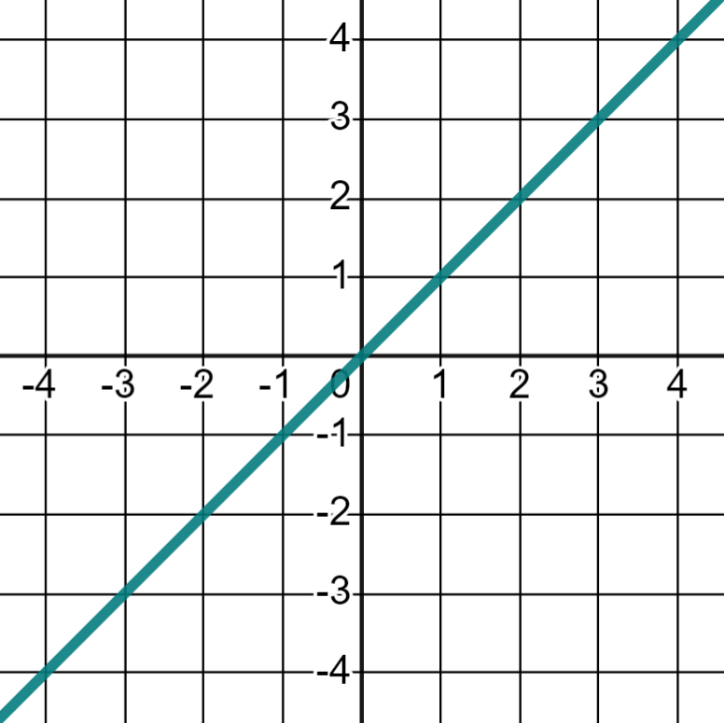
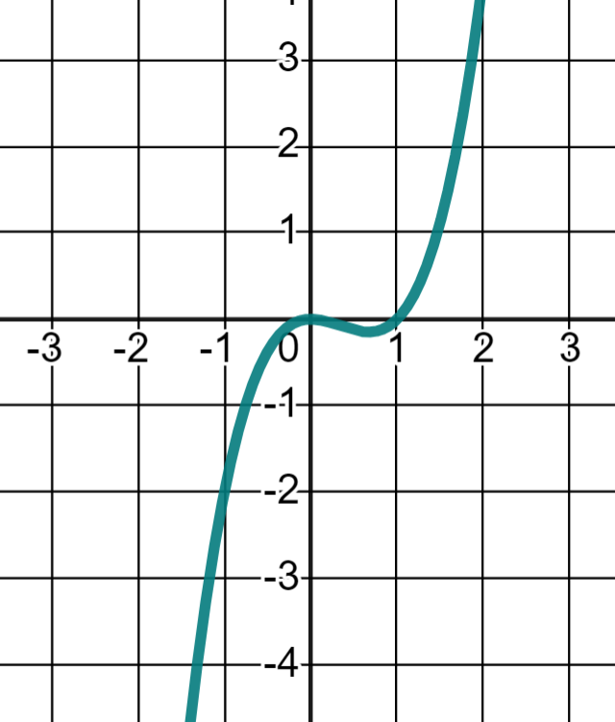
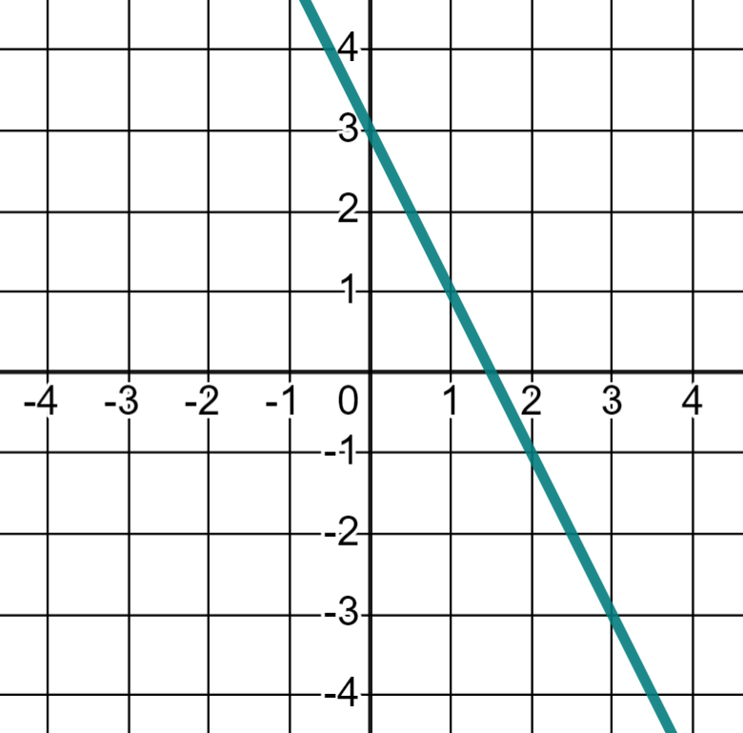
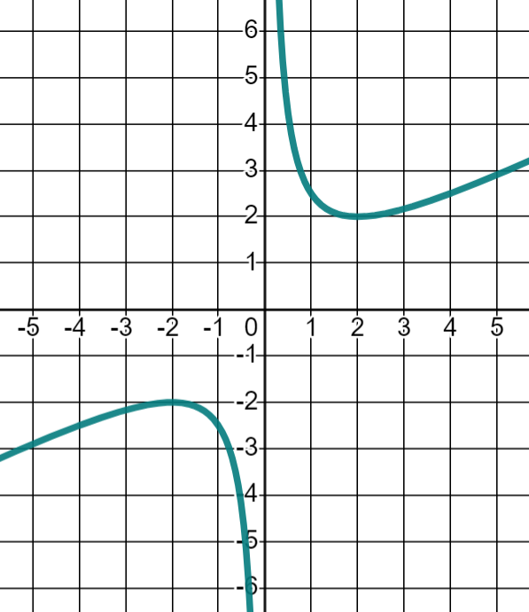
Identifying linear equations from graphs
1) Fill in the missing values in the tables. Using these, match the equations to the graphs and state whether each equation is linear or not.
A
B
C
D
x | −2 | −1 | 1 | 2
y
x | −2 | −1 | 1 | 2
y
x | −2 | −1 | 1 | 2
y
x | −2 | −1 | 1 | 2
y
E
F
G
H

Slide 38
Identifying linear equations from graphs
1) Fill in the missing values in the tables. Using these, match the equations to the graphs and state whether each equation is linear or not.
A
C
x | −2 | −1 | 1 | 2
y | −12 | −2 | 0 | 4
x | −2 | −1 | 1 | 2
y | −2 | −2.5 | 2.5 | 2
F
H
Non-linear
Non-linear

Slide 39
Identifying linear equations from graphs
1) Fill in the missing values in the tables. Using these, match the equations to the graphs and state whether each equation is linear or not.
B
D
x | −2 | −1 | 1 | 2
y | 7 | 5 | 1 | −1
x | −2 | −1 | 1 | 2
y | −2 | −1 | 1 | 2
G
E
Linear
Linear

Slide 40
Different types of equations
The relationship between 2 variables is linear if it forms a straight line when plotted on a graph.
We can graph an expression by looking at how the value of the expression changes as the variable changes.
We can identify linear and non-linear expressions from their graphical form.

Slide 41

© Oak National Academy 2023.
Produced in partnership with Mathematics in Education and Industry.
Licensed on the Open Government Licence v3.0, except where otherwise stated. See Oak terms and conditions.

